Slide 1
Symbolic Execution
Subtitle: A Deep Dive into Program Analysis Methods
Level : 3
Course: Software Engineering
Instructor :Associate Prof.Ibrahim Elawdy

Slide 2
Symbolic Execution
Names :
1- Omar Mohamed AbdElfatah Mohamed
2- Abdallah Ahmed Ali Ibrahim
3- Shahd Omar Ali Abdelall
4- Mariam Yosry Yousef
5- Yara Samir Shaban Yousef

Slide 3
Introduction
Definition: Symbolic execution is a program analysis technique.
Purpose: To explore all possible execution paths in a program.
Key Benefit: Enables rigorous testing and verification.

Slide 4
Key Concepts (1/2)
Symbolic Variables: Inputs are treated as symbols (e.g., X instead of 5).
Path Conditions (PC): Logical constraints defining execution paths.

Slide 5
Key Concepts (2/2)
Constraint Solvers: Tools to check if PCs are feasible.
Execution Tree: Represents all possible paths of a program.

Slide 6
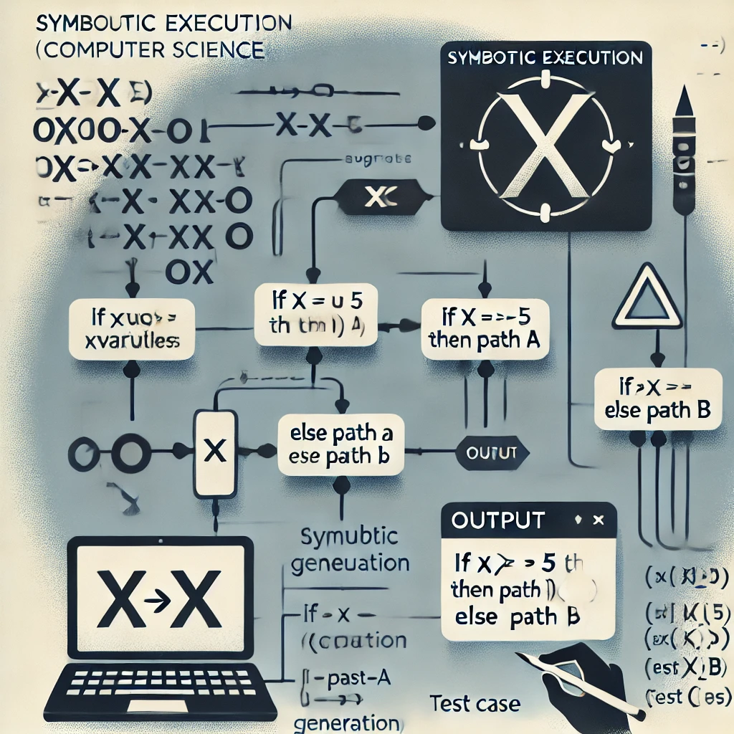
How Symbolic Execution Works
1. Initialize symbolic values for inputs.
2. Execute the program symbolically.
3. Explore all paths using path conditions.
4. Use constraint solvers to check feasibility.
5. Generate test cases for feasible paths.

Slide 7
Applications (1/2)
Software Testing: High-coverage test case generation, identifying edge cases.
Security Analysis: Finding vulnerabilities (e.g., buffer overflows).

Slide 8
Applications (2/2)
Program Verification: Ensuring correctness.
Debugging: Analyzing specific paths to find errors.

Slide 9
Advantages
Comprehensive path exploration.
Effective in uncovering bugs.
Automates test case generation.
Enhances program reliability.

Slide 10
Challenges
Path Explosion: Exponentially growing paths.
Complex Constraints: Difficult to solve efficiently.
Scalability: Issues with large systems.

Slide 11
Tools for Symbolic Execution
KLEE: For C/C++ programs.
SAGE: Security testing.
Z3 Solver: High-performance constraint solver.
CBMC: Combines symbolic execution with model checking.

Slide 12
Conclusion
Symbolic execution is a valuable tool for testing and verifying programs.
While challenges remain, advancements are improving scalability and efficiency.
Widely used in testing, debugging, and security.

Slide 13
References
Clarke, E. M., & Kroening, D. (2004). Symbolic Execution Techniques for Software Testing.
Cadar, C., & Sen, K. (2013). Symbolic Execution for Software Testing: Three Decades Later.
Documentation: KLEE, Z3 Solver, CBMC.

